Slide 1
Chapter 8
IP Subnetting,
Troubleshooting IP,
and Introduction
to NAT

Slide 2
Objectives
Given a scenario, evaluate the proper use of the following addressing technologies and addressing schemes

Slide 3
Subnetting Basics
There are loads of reasons in favor of subnetting, including the following benefits:
Reduced network traffic
Optimized network performance
Simplified management
Facilitated spanning of large geographical distances

Slide 4
How to Create Subnets
Determine the number of required network IDs
Determine the number of required host IDs per subnet
Based on the previous requirements, create the following
One subnet mask for your entire network
A unique subnet ID for each physical segment
A range of host IDs for each subnet

Slide 5
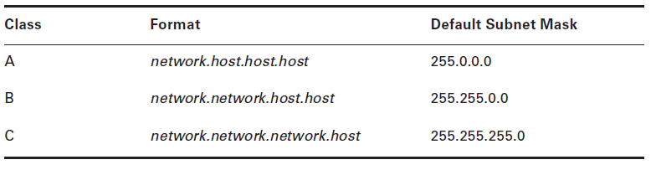
Subnet Masks
A subnet mask is a 32-bit value that allows the recipient of IP packets to distinguish the network ID portion of the IP address from the host ID portion of the IP address.

Slide 6
Classless Inter-Domain Routing (CIDR)
Subnet Mask | CIDR Value
255.0.0.0 | /8
255.128.0.0 | /9
255.192.0.0 | /10
255.224.0.0 | /11
255.240.0.0 | /12
255.248.0.0 | /13
255.252.0.0 | /14
255.254.0.0 | /15
255.255.0.0 | /16
255.255.128.0 | /17
255.255.192.0 | /18
255.255.224.0 | /19
255.255.240.0 | /20
255.255.248.0 | /21
255.255.252.0 | /22
255.255.254.0 | /23
255.255.255.0 | /24
255.255.255.128 | /25
255.255.255.192 | /26
255.255.255.224 | /27
255.255.255.240 | /28
255.255.255.248 | /29
255.255.255.252 | /30
It’s basically the method that Internet service providers (ISPs) use to allocate an amount of addresses to a company, a home—a customer. They provide addresses in a certain block size.

Slide 7
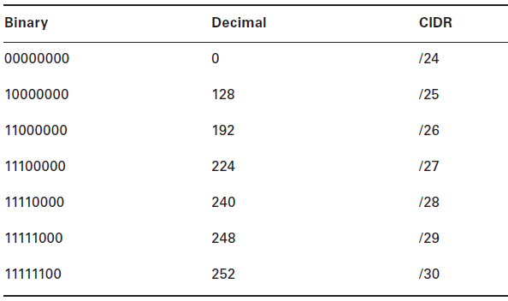
Subnetting Class C Addresses
The only Class C subnet masks can be the following:

Slide 8
Subnetting Class B Addresses
Class B network address has 16 bits available for host addressing.
255.255.0.0 | (/16)
255.255.128.0 | (/17)
255.255.192.0 | (/18)
255.255.224.0 | (/19)
255.255.240.0 | (/20)
255.255.248.0 | (/21)
255.255.252.0 | (/22)
255.255.254.0 | (/23)
255.255.255.0 | (/24)
255.255.255.128 | (/25)
255.255.255.192 | (/26)
255.255.255.224 | (/27)
255.255.255.240 | (/28)
255.255.255.248 | (/29)
255.255.255.252 | (/30)

Slide 9
Troubleshooting IP Addressing
DOS commands that you can use to help troubleshoot your network from both a PC and a Cisco router:
Packet InterNet Groper (ping)
traceroute
tracert
arp –a
ipconfig /all

Slide 10
Introduction to Network Address Translation (NAT)
Similar to Classless Inter-Domain Routing (CIDR), the original intention for NAT was to slow the depletion of available IP address space by allowing many private IP addresses to be represented by some smaller number of public IP addresses.
You need to connect to the Internet, and your hosts d NN on’t have globally unique IP addresses.
You change to a new ISP that requires you to renumber your network.
You need to merge two intranets with duplicate addresses.

Slide 11
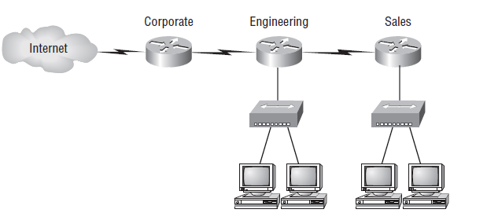
Introduction to Network Address Translation (NAT) (contd…)
Where to configure NAT

Slide 12
Types of Network Address Translation
Dynamic NAT
This version gives you the ability to map an unregistered IP address to a registered IP address from a pool of registered IP addresses.
Overloading
This is the most popular type of NAT configuration. Understand that overloading really is a form of dynamic NAT that maps multiple unregistered IP addresses to a single registered IP address—many-to-one—by using different ports.

Slide 13
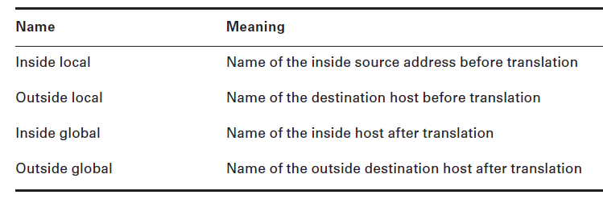
NAT Names
Addresses used after NAT translations are called global addresses.
Local addresses are the ones we use before NAT translation. So, the inside local address is actually the private address of the sending host that’s trying to get to the Internet, while the outside local address is the address of the destination host.

